Slide 1
CS 3006 Parallel and Distributed Computing Lecture 25
Danyal Farhat
FAST School of Computing
NUCES Lahore

Slide 2
Lecture 24 Hybrid Programming - (OpenMP + MPI)

Slide 3
Outline
Hybrid Programming with MPI and OpenMP
Hybrid Programming with MPI and OpenMP [Use Cases]
Helloworld.c Program
Hybrid_matrixVector.c Program
Hybrid_pi.c Program
MPI_Init_thread
MPI_THREAD_FUNNELED
MPI_THREAD_SERIALIZED
MPI_THREAD_MULTIPLE
Hybrid_multiple_support_sendRecv.c
Summary
Additional Resources

Slide 4
Hybrid Programming with MPI and OpenMP
Consider your cluster of workstations consists of different multicore processors
Launching a single MPI process for each of the workstations, may not optimally use the available resources
We can combine MPI and OpenMP to increase utilization of the resources by:
Using single MPI process per workstation
And generating different number of threads in each workstation
Each workstation can have different number of threads, according to their infrastructures

Slide 5
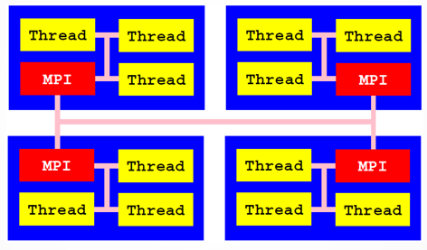
Hybrid Programming with MPI and OpenMP (Cont.)

Slide 6
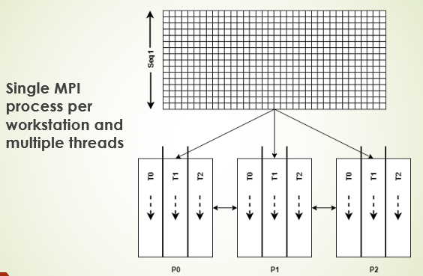
Hybrid Programming with MPI and OpenMP (Cont.)

Slide 7
Hybrid Programming with MPI and OpenMP [Use Cases]
The simplest and safe way to combine MPI with OpenMP is to never use the MPI calls inside the OpenMP parallel regions
MPI level communication must only be done by the master thread
main(int argc, char **argv) {
...
MPI_Init(&argc, &argv);
... // master thread only --> MPI calls here
#pragma omp parallel
{
. .. // team of threads --> no MPI calls here
}
... // master thread only --> MPI calls here
MPI_Finalize();
}

Slide 8
Helloworld.c Program
MPI_Init(&argc, &argv);
int P , name_len;
MPI_Comm_size(MPI_COMM_WORLD, &P);
int process_id;
MPI_Comm_rank(MPI_COMM_WORLD, &process_id);
char processor_name[MPI_MAX_PROCESSOR_NAME];
MPI_Get_processor_name(processor_name, &name_len);
omp_set_dynamic(0);
omp_set_num_threads(omp_get_num_procs());
int thread_id;

Slide 9
Helloworld.c Program (Cont.)
#pragma omp parallel private(thread_id)
{
thread_id = omp_get_thread_num();
printf("From Process#%d thread_id %d out of %d mapped on processor:%s Hello Hybrid\n", process_id, thread_id, omp_get_num_threads(), processor_name);
}
MPI_Finalize();
}

Slide 10
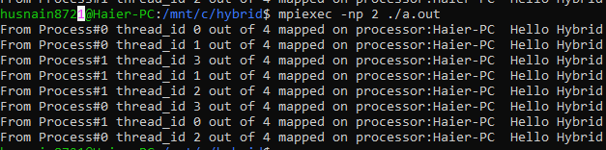
Helloworld.c Program (Cont.)
Important: At header files include both mpi.h and omp.h
Compiling the program:
mpicc -fopenmp ./helloworld.c -o ./a.out
Executing the program:
mpiexec -np 2 ./a.out

Slide 11
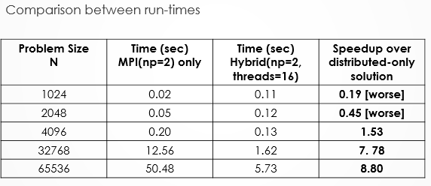
Hybrid_matrixVector.c Program
Hybrid_matrixVector.c Program:

Slide 12
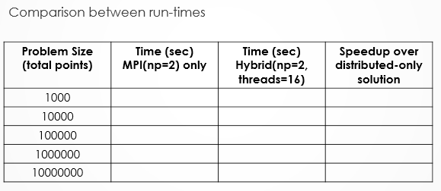
Hybrid_pi.c Program
Hybrid_pi.c Program:

Slide 13
MPI_Init_thread
Till now we have only seen solutions that don’t require inter-workstation (OR MPI level) communication in the parallel region
What if we try to use MPI calls within openmp parallel regions?
Default calls for MPI-1 primitive routines are not thread safe
May result in strange outputs
So, solution?
Use MPI_Init_thread() with MPI_THREAD_MULTIPLE as support level instead of simple MPI_init() call for starting the program

Slide 14
MPI_Init_thread (Cont.)
int MPI_Init_thread (int *argc, char ***argv, int required, int *provided)
MPI_Init_thread() initializes the MPI execution environment (similar to MPI_Init())
Defines the support level for multithreading
Required is the aimed support level
Provided is the support level provided by the MPI implementation

Slide 15
MPI_Init_thread (Cont.)
int MPI_Init_thread(int *argc, char ***argv, int required, int *provided)
Available Support Levels:
MPI_THREAD_SINGLE – only one thread will execute (the same as initializing the environment with MPI_Init())
MPI_THREAD_FUNNELED – only the master thread can make MPI calls
MPI_THREAD_SERIALIZED – all threads can make MPI calls, but only one thread at a time can be in such state
MPI_THREAD_MULTIPLE – all threads can make simultaneous MPI calls without any constraints

Slide 16
MPI_THREAD_FUNNELED
With support level MPI_THREAD_FUNNELED only the master thread can make MPI calls
One way to ensure this is to protect the MPI calls with the omp master directive
#pragma omp parallel
{
...
#pragma omp barrier // explicit barrier at entrance
#pragma omp master // only the master thread makes the MPI call
mpi_call();
#pragma omp barrier // explicit barrier at exit
...
}

Slide 17
MPI_THREAD_SERIALIZED
Only one thread at a time will make calls to the MPI library, but all threads are eligible to make such calls as long as they do not do so at the same time
#pragma omp parallel private(tid) num_threads(2)
{
tid = omp_get_thread_num();
if(tid== 0){ mpi_call(); }
#pragma omp barrier // barrier so that other threads don’t enter next mpi call
if(tid== 1){ mpi_call(); }
#pragma omp barrier // explicit barrier
...
}

Slide 18
MPI_THREAD_MULTIPLE
All the threads can make simultaneous MPI calls without any constraints
No need of any barrier synchronizations among the threads
MPI library is then responsible for thread safety within that library, and for any libraries that it in turn uses
#pragma omp parallel private(tid) num_threads(2)
{
….
tid = omp_get_thread_num();
mpi_call(); //all the threads will call this mpi routine parallely
...
}

Slide 19
MPI_THREAD_MULTIPLE (Cont.)
How to identify the thread number that is involved in the communication?
You can pass threadID as message tag
The receiving process then can identify each message from the source uniquely
#pragma omp parallel private(tid) num_threads(2)
{
…
tid= omp_get_thread_num();
If (my_rank == 0) // MPI process 0 sends 2 messages
MPI_Send(a, 1, MPI_INT, 1, tid, MPI_COMM_WORLD);
else if (my_rank == 1) // MPI process 1 receives 2 messages
MPI_Recv(b, 1, MPI_INT, 0, tid, MPI_COMM_WORLD, &status);
...
}

Slide 20
Hybrid_multiple_support_sendRecv.c
Program uses MPI_THREAD_MULTIPLE as level of support
The program basically implements a naïve hybrid one-to-all broadcast of a buffer containing 4 integers
Source process uses 4 threads, where each thread is responsible of sending one integer to all the other processes
While receiving processes also use 4 threads, each which receives a single integer from the source process and copies it into correct position in the receive buffer

Slide 21
Hybrid_multiple_support_sendRecv.c (Cont.)
For 2 MPI processes and sendbuff=[2,4,6,8]
process_id:0-->thread#0 is sending 2 to process 1
process_id:0-->thread#1 is sending 4 to process 1
process_id:0-->thread#2 is sending 6 to process 1
process_id:0-->thread#3 is sending 8 to process 1
process-id:1 Received 2 from thread#0 of source
process-id:1 Received 4 from thread#1 of source
process-id:1 Received 6 from thread#2 of source
process-id:1 Received 8 from thread#3 of source
Recvbuff = 2 4 6 8

Slide 22
Hybrid_multiple_support_sendRecv.c (Cont.)
For 4 MPI processes [Source Process output]
process_id:0-->thread#0 is sending 2 to process 1
process_id:0-->thread#0 is sending 2 to process 2
process_id:0-->thread#0 is sending 2 to process 3
process_id:0-->thread#1 is sending 4 to process 1
process_id:0-->thread#1 is sending 4 to process 2
process_id:0-->thread#1 is sending 4 to process 3
process_id:0-->thread#2 is sending 6 to process 1
process_id:0-->thread#2 is sending 6 to process 2
process_id:0-->thread#2 is sending 6 to process 3
process_id:0-->thread#3 is sending 8 to process 1
process_id:0-->thread#3 is sending 8 to process 2
process_id:0-->thread#3 is sending 8 to process 3

Slide 23
Hybrid_multiple_support_sendRecv.c (Cont.)
For 4 MPI processes [receiving processes output]
process-id:1 Received 2 from thread#0 of source
process-id:1 Received 4 from thread#1 of source
process-id:1 Received 6 from thread#2 of source
process-id:1 Received 8 from thread#3 of source
process-id:2 Received 2 from thread#0 of source
process-id:2 Received 4 from thread#1 of source
process-id:2 Received 6 from thread#2 of source
process-id:2 Received 8 from thread#3 of source
process-id:3 Received 2 from thread#0 of source
process-id:3 Received 6 from thread#2 of source
process-id:3 Received 4 from thread#1 of source
process-id:3 Received 8 from thread#3 of source
Recvbuff = 2 4 6 8

Slide 24
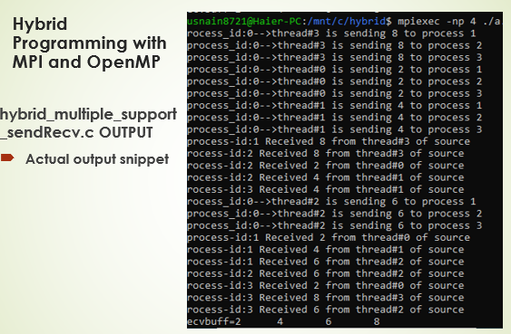
Hybrid_multiple_support_sendRecv.c (Cont.)

Slide 25
Summary
Hybrid Programming with MPI and OpenMP
Hybrid Programming with MPI and OpenMP [Use Cases]
Helloworld.c Program
Hybrid_matrixVector.c Program
Hybrid_pi.c Program
MPI_Init_thread
MPI_THREAD_FUNNELED
MPI_THREAD_SERIALIZED
MPI_THREAD_MULTIPLE
Hybrid_multiple_support_sendRecv.c

Slide 26
Additional Resources
Introduction to Parallel Computing by Ananth Grama and Anshul Gupta
Chapter 6: Programming Using Message Passing Paradigm

Slide 27
Questions?

